Slide 1
GTÜ BİL MUH BİL 495 ve 496 Preliminary Presentation
BIL 495
Preliminary Presentation
Derviş Ali Duman
Proje Danışmanı: Dr. Alp Arslan BAYRAKÇI
October 2022

Slide 2
Content
Project Diagram and Description
Project Design Plan
Project Requirements
Success Criterias
Resources

Slide 3
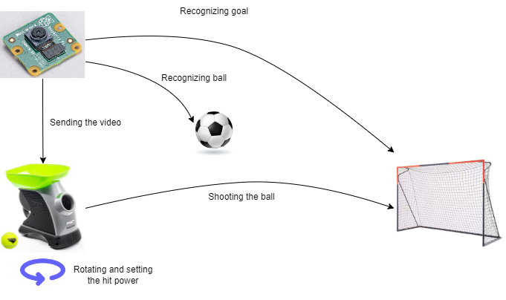
Project Diagram and Description
Soccer machine:
A robot that detects the ball and the soccer goal by processing images.
Detects if it was a goal or not by image processing.
Uses the machine learning for more accurate shots.
A robot that detects the ball and the soccer goal, then scores almost every time.

Slide 4
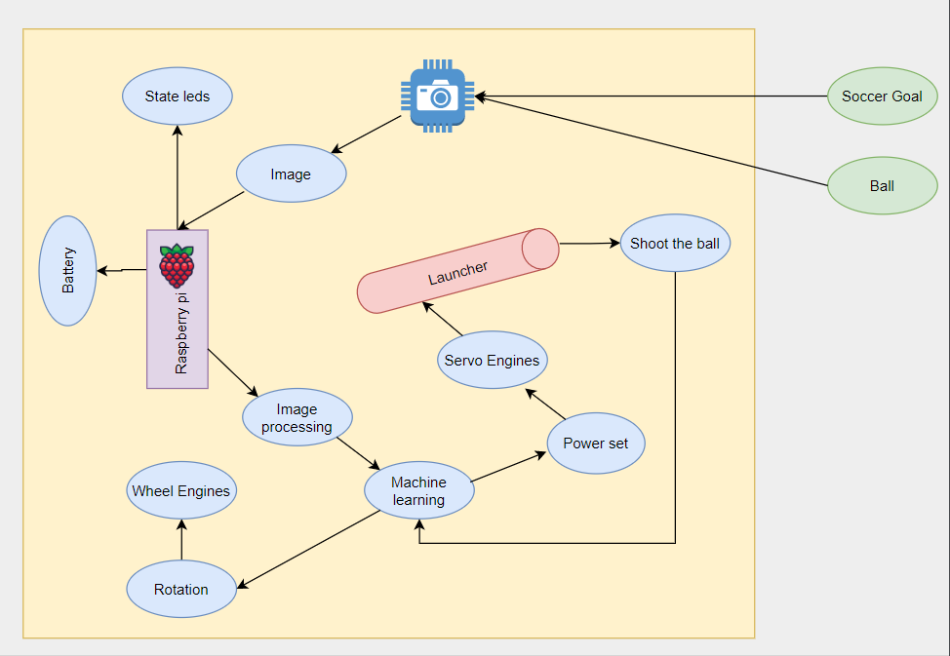
Project Design Plan

Slide 5
Project Requirements - 1
For this project:
Drawing the baseline of the robot.
Designing the shooting mechanism.
Taking some pictures from the camera connected to robot.
Training the machine with soccer goal and ball images.
Making sure the robot can detect if it was a score or not.
Adding different hit powers and angles.
Stabilizing the shooting mechanism if everything is okay for the machine learning.
Train the machine for more accurate shots for different angles and different distance.

Slide 6
Project Requirements - 2
For robot requirements:
Raspberry pi 3, camera, 3 led, a button, 2 switch, 2 wheels, 5 servo engine, battery, power distribution board, 2 engine.
For software Requirements:
Python, openCV, machine learning algorithm
Other Requirements:
Fusion 360, ultimaker cura, 3D printed equipements such as case for robot, soccer goal.

Slide 7
Success Criterias
Almost every shot (%90) should be a goal as you shoot more and more.
Shooting can be successful at different distances.
Shooting can be successful at different angles.

Slide 8
Resources
https://www.amazon.com/Franklin-Pet-Supply-Automatic-Launcher/dp/B07PBCYKHB (launcher example machine)
https://www.britannica.com/sports/ball-sports (ball example)
https://www.decathlon.com.tr/p/futbol-kalesi-l-boy-lacivert-turuncu-classic-500/_/R-p-327912 (soccer goal example)
https://www.amazon.ca/Raspberry-Pi-Camera-Module-Megapixel/dp/B01ER2SKFS (camera example)

